Slide 1
SALES DASHBOARD II
Methodology, Insights and Recommendations

Slide 2
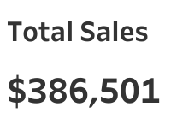
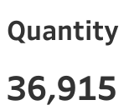
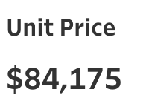

Slide 3
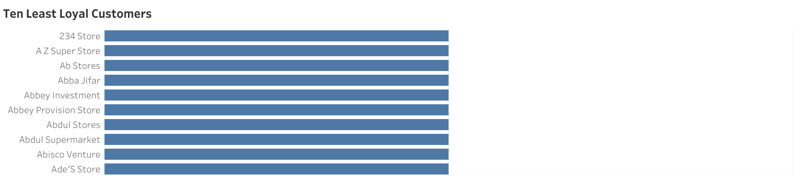
Insight: The top 10 least loyal customers are identified, including 234 Stores, A Z Superstore, and Ab Stores, who have the fewest number of orders. Recommendation: Develop targeted engagement strategies such as personalized offers and loyalty programs to increase repeat purchases from these customers.

Slide 4
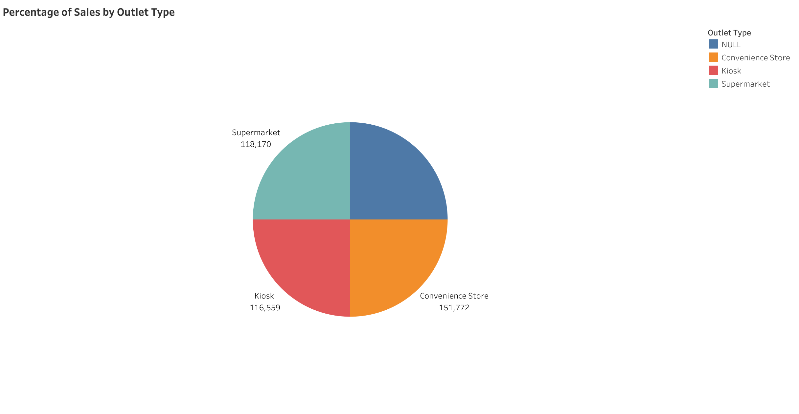
Insight: Convenience stores account for the highest percentage of sales at 39%, followed by supermarkets at 31% and kiosks at 30%. Recommendation: Allocate more resources and marketing efforts towards convenience stores to capitalize on their high sales volume while exploring strategies to boost sales in supermarkets and kiosks.

Slide 5
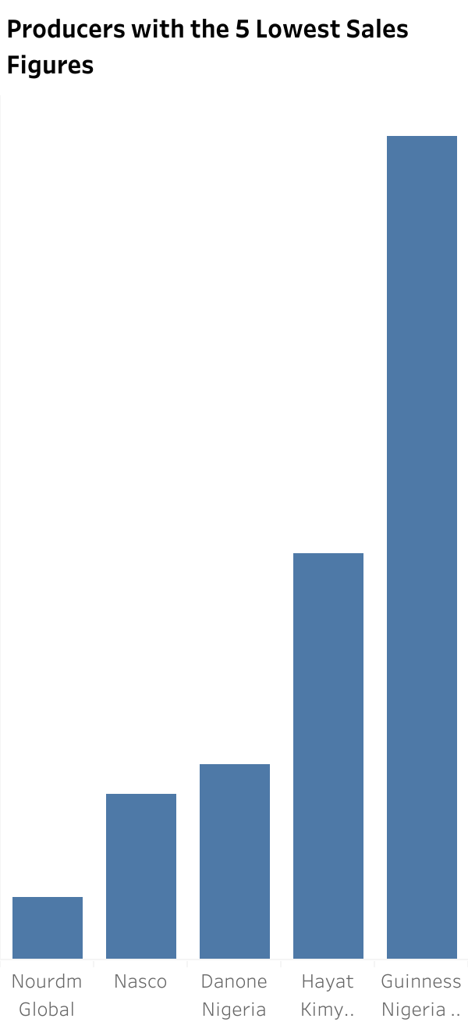
Insight: The producer with the lowest sales figure is Nourdm with 2,094, followed by other producers up to Guinness with 27,450. Recommendation: Conduct a thorough review of these producers to understand the reasons behind their low sales and consider renegotiating terms or forming strategic partnerships to boost their performance.

Slide 6
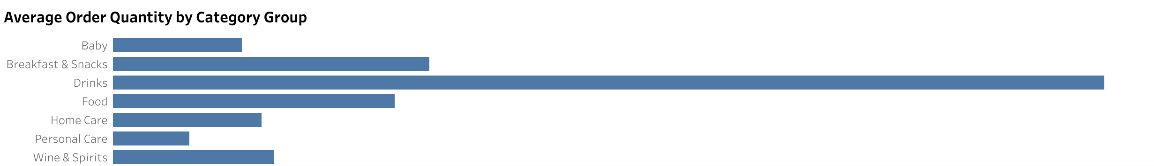
Insight: The Drinks category group has the highest average order quantity at 17.57, while the Personal Care category has the lowest average order quantity at 1.36. Recommendation: Ensure sufficient stock for high-demand categories like Drinks and increase marketing efforts for lower-demand categories like Personal Care to boost their order quantities.

Slide 7
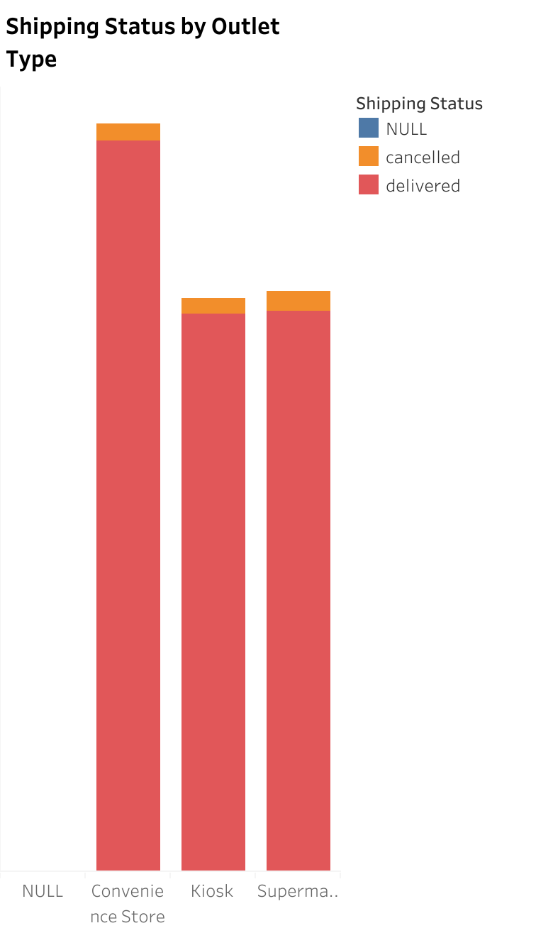
Insight: Convenience stores have the highest number of sales and delivered shipping statuses, followed by kiosks and supermarkets with a slight difference between the two. Recommendation: Focus on optimizing shipping processes for convenience stores and identify and address any shipping challenges faced by kiosks and supermarkets to enhance their delivery efficiency.

Slide 8
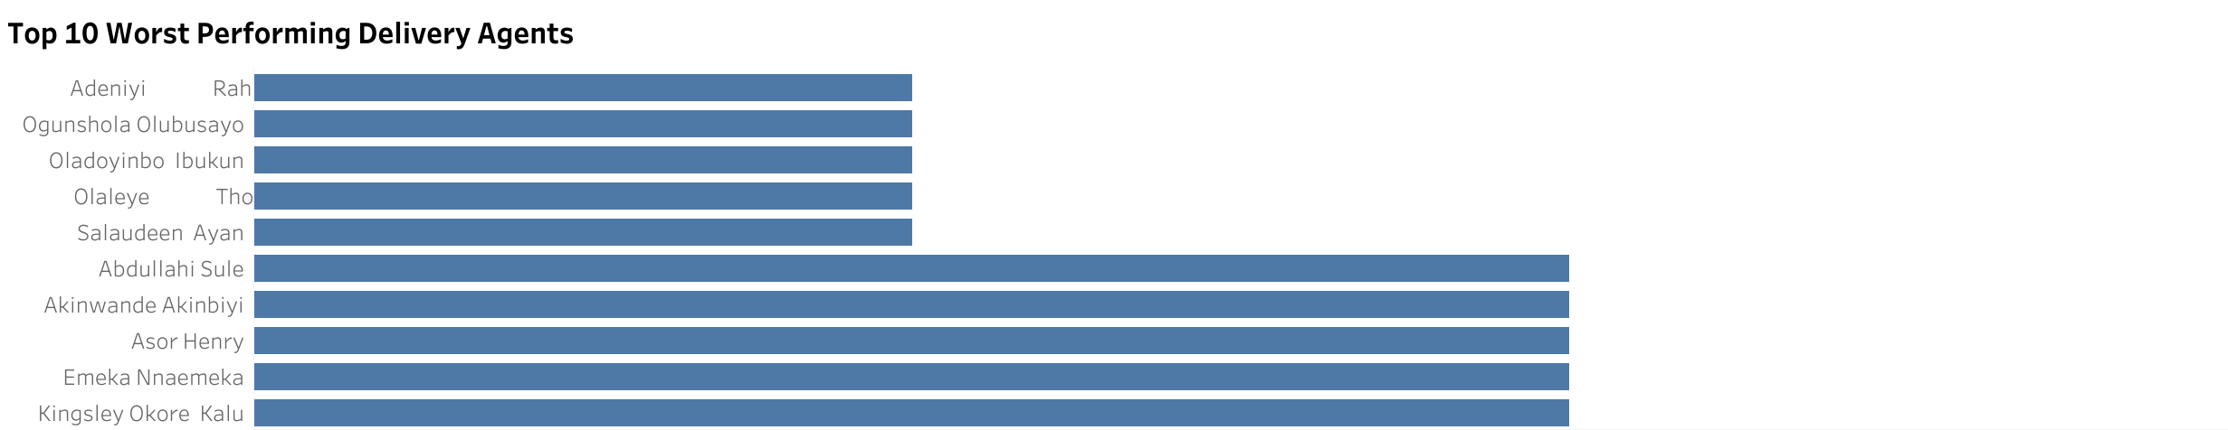
Insight: The top 10 worst performing delivery agents are clearly identified in the bar chart. Recommendation: Implement training programs and performance improvement plans for the worst performing delivery agents and regularly monitor their performance for continuous improvement.

Slide 9
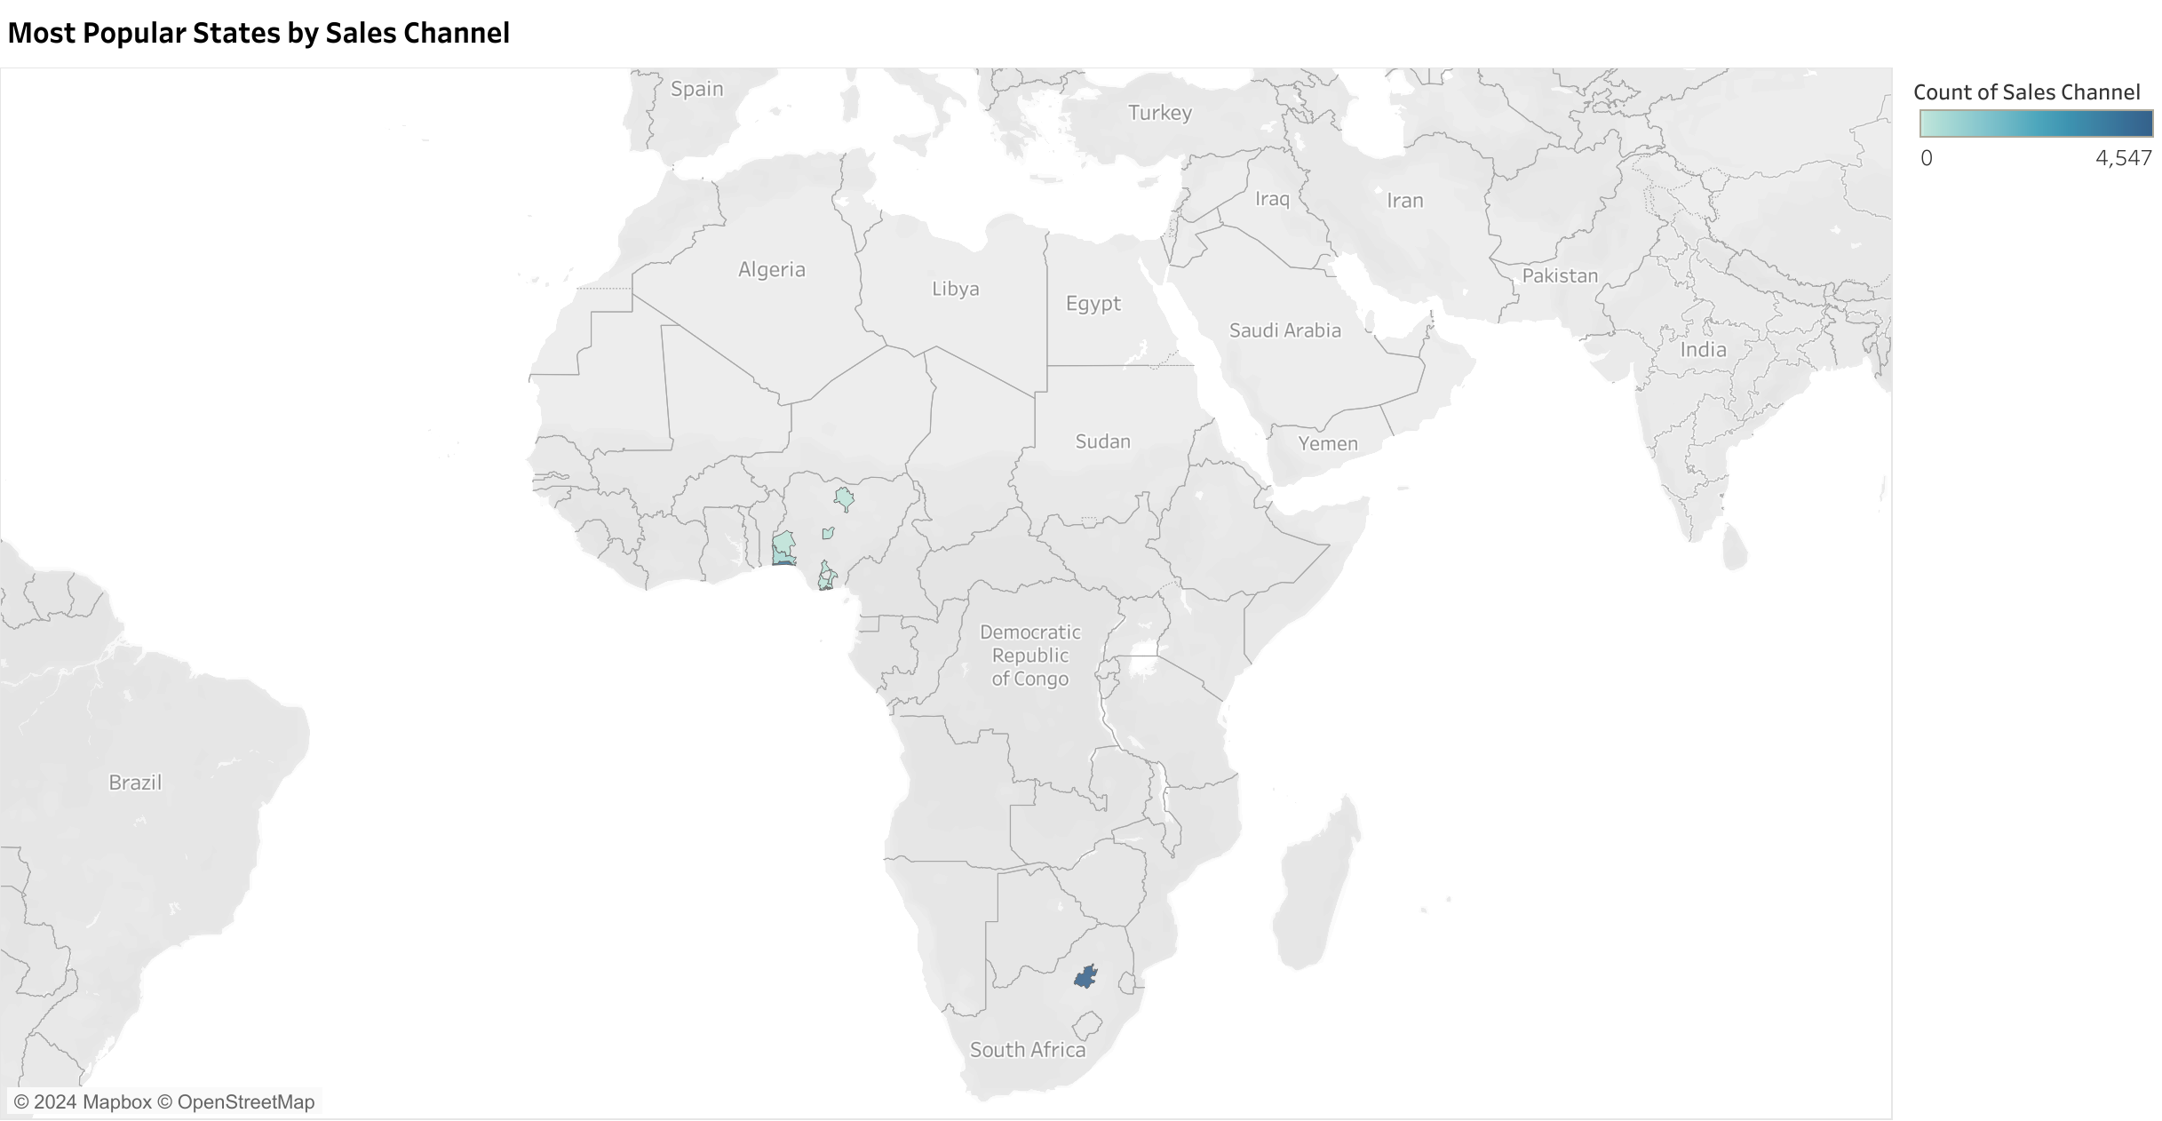
Insight: Gauteng in ZA is the most popular state with 4,574 in sales, as shown in the map. Recommendation: Launch targeted marketing campaigns in Gauteng to further increase sales and consider expanding operations and resources in other states to balance sales distribution.

Slide 10
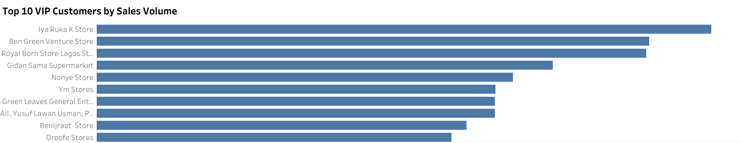
Insight: The top 10 VIP customers, identified by their sales volume, are clearly shown in the bar chart. Recommendation: Provide special offers, personalized services, and exclusive rewards to retain these high-value customers and use their insights to replicate successful strategies for other customers.

Slide 11
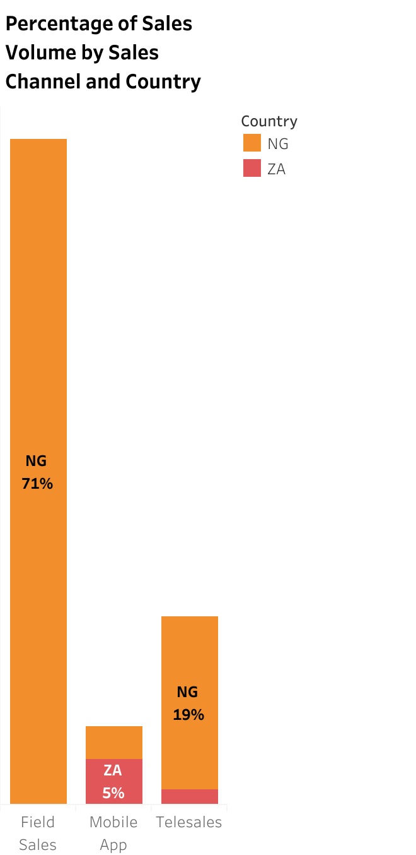
Insight: The stacked bar chart shows that NG has the highest percentage of sales at 71% through the field sales channel. Recommendation: Optimize and invest in the field sales channel in NG to maintain and grow its high sales volume, while exploring and developing other sales channels in NG and other countries to diversify and increase overall sales.

Slide 12
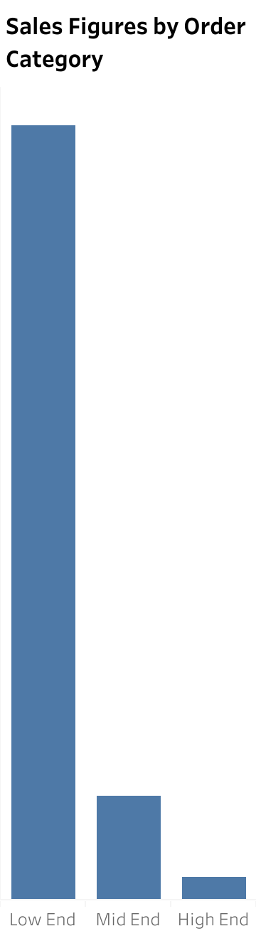
Insight: The low-end category has the highest sales figure at 332,208, followed by the mid-end category, with the high-end category having the least sales. Recommendation: Conduct market analysis to understand the high demand for low-end products and strategize to maintain this trend while exploring opportunities to enhance the mid-end and high-end product offerings to boost their sales figures and implementing targeted promotional campaigns for these categories.

Slide 13
Overall Insights
The analysis revealed that the top 10 least loyal customers have the fewest orders, convenience stores lead sales at 39%, Nourdm has the lowest sales figures, Drinks have the highest average order quantity, convenience stores show the highest sales and delivered shipping statuses, the bottom 10 delivery agents are underperforming, Gauteng in ZA leads in sales volume, the top 10 VIP customers contribute significantly to sales, NG leads with 71% of sales through field sales, and low-end products dominate sales figures.
Recommendations
To improve customer retention, implement targeted engagement strategies and gather feedback; allocate more resources towards convenience stores while boosting supermarket and kiosk sales; review and potentially renegotiate terms with underperforming producers; ensure sufficient stock for high-demand categories and increase marketing for lower-demand ones; optimize shipping processes for convenience stores and address challenges for kiosks and supermarkets; provide training and monitor performance for underperforming delivery agents; launch targeted campaigns in Gauteng and expand in other states; offer special rewards and personalized services to VIP customers and apply successful strategies to other customers; optimize the field sales channel in NG while exploring other channels in different countries; and conduct market analysis to maintain the demand for low-end products while enhancing mid and high-end offerings with targeted promotions.
Conclusion
The analysis has highlighted critical areas for improvement across customer loyalty, sales distribution, producer performance, order quantity, shipping efficiency, delivery agent performance, regional sales, VIP customer engagement, and sales channel optimization. Implementing the recommendations can significantly enhance overall performance and drive growth.
Next Steps
The next steps involve developing and executing targeted engagement and marketing strategies, optimizing resource allocation, addressing underperformance in producers and delivery agents, improving shipping processes, expanding regional operations, and maintaining a balanced product offering through market analysis and promotional efforts.

Slide 14
THANK YOU

